Slide 1

Chapter 7 Wireless and
Mobile Networks
김선명
컴퓨터소프트웨어공학과
Computer Networking: A Top Down Approach
7th Edition, Global Edition Jim Kurose, Keith Ross Pearson April 2016

Slide 2
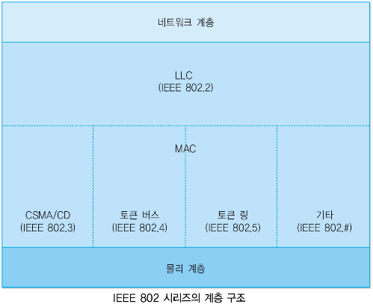
Link Layer

Slide 3
Link Layer
Model
LAN
Data
Link
LLC
Ethernet
IEEE 802.2 LLC
MAC
IEEE 802.3 (CSMA/CD)
IEEE 802.4 (Token Bus)
IEEE 802.5 (Token Ring)
FDDI
IEEE 802.11 (WLAN)
IEEE 802.11 MAC
(CSMA/CA)
Physical
IR
FHSS
DSSS
OFDM

Slide 4
Link Layer
LLC (Logical Link Control)
MAC 계층과의 독립성 유지
여러 다양한 매체접속제어(MAC) 방식 간의 차이를 보완하여 주는 역할을 함
여러 다양한 MAC 부계층과 네트워크계층 간의 접속을 담당
에러제어
흐름제어
MAC (Media Access Control)
각 장치의 물리적 주소 지정 (MAC 주소)
네트워크 토폴로지 정의 (Bus, Ring, Star, ...)
매체에서의 전송 방법 (ALOHA, CSMA, CSMA/CD, ...)

Slide 5
Ch. 7: Wireless and Mobile Networks
Background:
# wireless (mobile) phone subscribers now exceeds # wired phone subscribers (5-to-1)!
# wireless Internet-connected devices equals # wireline Internet-connected devices
laptops, Internet-enabled phones promise anytime untethered Internet access
two important (but different) challenges
wireless: communication over wireless link
mobility: handling the mobile user who changes point of attachment to network

Slide 6
Chapter 7 outline
7.1 Introduction
Wireless
7.2 Wireless links, characteristics
CDMA
7.3 IEEE 802.11 wireless LANs (“Wi-Fi”)
7.4 Cellular Internet Access
architecture
standards (e.g., 3G, LTE)
Mobility
7.5 Principles: addressing and routing to mobile users
7.6 Mobile IP
7.7 Handling mobility in cellular networks
7.8 Mobility and higher-layer protocols

Slide 7




Elements of a wireless network
network
infrastructure

Slide 8


Elements of a wireless network
wireless hosts
laptop, smartphone
run applications
may be stationary (non-mobile) or mobile
wireless does not always mean mobility
network
infrastructure

Slide 9

Elements of a wireless network
base station
typically connected to wired network
relay - responsible for sending packets between wired network and wireless host(s) in its “area”
e.g., cell towers, 802.11 access points
network
infrastructure

Slide 10
Elements of a wireless network
wireless link
typically used to connect mobile(s) to base station
also used as backbone link
multiple access protocol coordinates link access
various data rates, transmission distance
network
infrastructure

Slide 11
Characteristics of selected wireless links
1300
802.11 ac
450
802.11n
54
802.11a,g
802.11a,g point-to-point
5-11
802.11b
4G: LTWE WIMAX
4
3G: UMTS/WCDMA-HSPDA, CDMA2000-1xEVDO
Data rate (Mbps)
1
802.15
.384
2.5G: UMTS/WCDMA, CDMA2000
.056
2G: IS-95, CDMA, GSM
Indoor
10-30m
Outdoor
50-200m
Mid-range
outdoor
200m – 4 Km
Long-range
outdoor
5Km – 20 Km

Slide 12
Elements of a wireless network
infrastructure mode
base station connects mobiles into wired network
handoff: mobile changes base station providing connection into wired network
network
infrastructure

Slide 13
Elements of a wireless network
ad hoc mode
no base stations
nodes can only transmit to other nodes within link coverage
nodes organize themselves into a network: route among themselves

Slide 14
Wireless network taxonomy
single hop
multiple hops
host connects to
base station (WiFi,
WiMAX, cellular)
which connects to
larger Internet
host may have to
relay through several
wireless nodes to
connect to larger
Internet: mesh net
infrastructure
(e.g., APs)
no base station, no
connection to larger
Internet. May have to
relay to reach other
a given wireless node
MANET, VANET
no
infrastructure
no base station, no
connection to larger
Internet (Bluetooth,
ad hoc nets)

Slide 15
Chapter 7 outline
7.1 Introduction
Wireless
7.2 Wireless links, characteristics
7.3 IEEE 802.11 wireless LANs (“Wi-Fi”)

Slide 16
Wireless Link Characteristics (1)
important differences from wired link ….
decreased signal strength: radio signal attenuates as it propagates through matter (path loss)
interference from other sources: standardized wireless network frequencies (e.g., 2.4 GHz) shared by other devices (e.g., phone); devices (motors) interfere as well
multipath propagation: radio signal reflects off objects ground, arriving at destination at slightly different times
…. make communication across (even a point to point) wireless link much more “difficult”

Slide 17
Wireless Link Characteristics (2)
SNR: signal-to-noise ratio
larger SNR – easier to extract signal from noise (a “good thing”)
SNR versus BER tradeoffs
given physical layer: increase power -> increase SNR->decrease BER
given SNR: choose physical layer that meets BER requirement, giving highest througput
SNR may change with mobility: dynamically adapt physical layer (modulation technique, rate)
10⁻¹
10⁻²
10⁻³
BER
10⁻⁴
10⁻⁵
10⁻⁶
10⁻⁷
10
20
30
40
SNR(dB)
QAM256 (8 Mbps)
QAM16 (4 Mbps)
BPSK (1 Mbps)

Slide 18


Wireless network characteristics
Multiple wireless senders and receivers create additional problems (beyond multiple access):
A
B
C
C
A’s signal
strength
C’s signal
strength
B
A
Hidden terminal problem
B, A hear each other
B, C hear each other
A, C can not hear each other means A, C unaware of their interference at B
space
Signal attenuation:
B, A hear each other
B, C hear each other
A, C can not hear each other interfering at B

Slide 19
Chapter 7 outline
7.1 Introduction
Wireless
7.2 Wireless links, characteristics
7.3 IEEE 802.11 wireless LANs (“Wi-Fi”)

Slide 20
IEEE 802.11 Wireless LAN
802.11b
2.4-5 GHz unlicensed spectrum
up to 11 Mbps
direct sequence spread spectrum (DSSS) in physical layer
all hosts use same chipping code
802.11a
5-6 GHz range
up to 54 Mbps
802.11g
2.4-5 GHz range
up to 54 Mbps
802.11n: multiple antennae
2.4-5 GHz range
up to 200 Mbps
all use CSMA/CA for multiple access
all have base-station and ad-hoc network versions

Slide 21




802.11 LAN architecture
wireless host communicates with base station
base station = access point (AP)
Basic Service Set (BSS) (aka “cell”) in infrastructure mode contains:
wireless hosts
access point (AP): base station
ad hoc mode: hosts only
Internet
hub, switch
or router
BSS 1
BSS 2

Slide 22
802.11: Channels, association
802.11b: 2.4GHz-2.485GHz spectrum divided into 11 channels at different frequencies
AP admin chooses frequency for AP
interference possible: channel can be same as that chosen by neighboring AP!
host: must associate with an AP
scans channels, listening for beacon frames containing AP’s name (SSID) and MAC address
selects AP to associate with
may perform authentication [Chapter 8]
will typically run DHCP to get IP address in AP’s subnet

Slide 23


802.11: passive/active scanning
BBS 1
BBS 2
BBS 1
BBS 2
1
AP 2
AP 1
1
1
AP 2
AP 1
2
2
2
3
3
4
H1
H1
passive scanning:
beacon frames sent from APs
association Request frame sent: H1 to selected AP
association Response frame sent from selected AP to H1
active scanning:
Probe Request frame broadcast from H1
Probe Response frames sent from APs
Association Request frame sent: H1 to selected AP
Association Response frame sent from selected AP to H1

Slide 24
IEEE 802.11: multiple access
DCF mode
No controller
Contention-based access
Best-effort delivery
Useful in ad hoc networks
Fair access to the channel
CSMA/CA
Mandatory
PCF mode
Central controller (AP)
Contention-free access
Time-bounded transfer
Polling
Optional
DCF(Distributed Coordination Function)
PCF(Point Coordination Function)
Basic method
DATA→ACK
Short packet length
Mandatory
RTS/CTS method
RTS→CTS→DATA→ACK
Long packet length
Hidden terminal problem
Optional

Slide 25



IEEE 802.11: multiple access
avoid collisions: 2⁺ nodes transmitting at same time
802.11: CSMA - sense before transmitting
don’t collide with ongoing transmission by other node
802.11: no collision detection!
difficult to receive (sense collisions) when transmitting due to weak received signals (fading)
can’t sense all collisions in any case: hidden terminal, fading
goal: avoid collisions: CSMA/C(ollision)A(voidance)
A
B
C
C
B
A’s signal
strength
C’s signal
strength
A
space

Slide 26
IEEE 802.11 MAC Protocol: CSMA/CA
802.11 sender
1 if sense channel idle for DIFS then
transmit entire frame (no CD)
2 if sense channel busy then
start random backoff time
timer counts down while channel idle
transmit when timer expires
if no ACK, increase random backoff interval, repeat 2
802.11 receiver
- if frame received OK
return ACK after SIFS (ACK needed due to hidden terminal problem)
sender
receiver
DIFS
data
SIFS
ACK
DCF Interframe Space (DIFS)
Short Interframe Space (SIFS)

Slide 27
IEEE 802.11 MAC Protocol: CSMA/CA
Sense the channel
Sense the channel
DIFS
Channel Busy
Backoff
Transmit Data
Sender 1
DIFS
Channel Busy
Backoff
Sender 2
DIFS
Backoff
Sender 3
Time

Slide 28
Avoiding collisions (more)
idea: allow sender to “reserve” channel rather than random access of data frames: avoid collisions of long data frames
sender first transmits small request-to-send (RTS) packets to BS using CSMA
RTSs may still collide with each other (but they’re short)
BS broadcasts clear-to-send (CTS) in response to RTS
CTS heard by all nodes
sender transmits data frame
other stations defer transmissions
avoid data frame collisions completely
using small reservation packets!

Slide 29


Collision Avoidance: RTS-CTS exchange
A
B
AP
RTS(B)
RTS(A)
reservation collision
RTS(A)
CTS(A)
CTS(A)
DATA (A)
defer
time
ACK(A)
ACK(A)

Slide 30
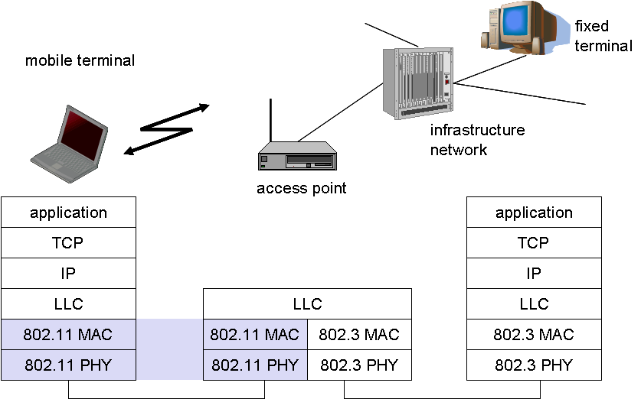
802.11 frame: addressing
802.11 Frame
802.3 Frame

Slide 31

802.11 frame: addressing
2
2
6
6
6
2
6
0 - 2312
4
frame
control
duration
address
1
address
2
address
3
seq
control
address
4
payload
CRC
Address 4: used only in ad hoc mode
Address 1: MAC address
of wireless host or AP
to receive this frame
Address 3: MAC address
of router interface to which AP is attached
Address 2: MAC address
of wireless host or AP
transmitting this frame
802.3 Frame
(Ethernet)

Slide 32

802.11 frame: addressing
Internet
H1
R1
router
AP
R1 MAC addr H1 MAC addr
dest. address
source address
802.3 frame
AP MAC addr H1 MAC addr R1 MAC addr
address 1
address 2
address 3
802.11 frame

Slide 33
802.11 frame: addressing
Internet
H1
R1
router
AP
H1 MAC addr R1 MAC addr
dest. address
source address
802.3 frame
H1 MAC addr AP MAC addr R1 MAC addr
address 1
address 2
address 3
802.11 frame

